Slide 1

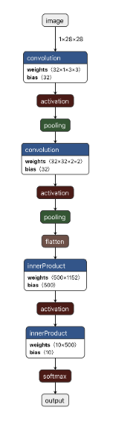








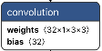
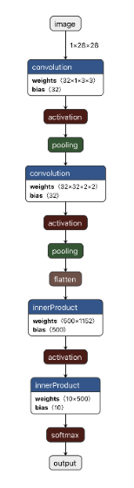
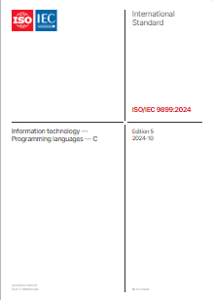

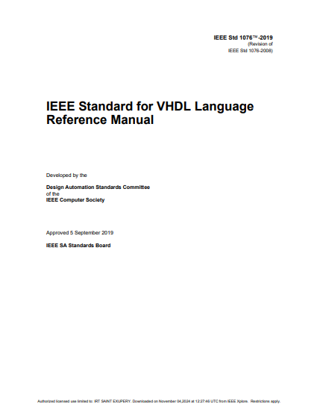
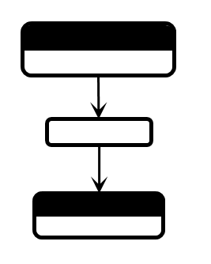



The SONNX workgroup Objectives
Preserves the semantics of
FPGA
FPGA
ML model
ML-based SW/HW item
source code
ML-based SW/HW Item implementation
Is the semantics clear enough?
Clarify
Comply with
Comply with
Comply with
Operators
Operators
semantics
Are the description of operators and graphs clearly and unambiguously defined by the standard?
What needs to be improved?
For what part of the standard?
Clarify
Graph
Graph
Safe
semantics
S
ABI
Language standards
Binary standards
ML standards
Update
File format
File format

Slide 2
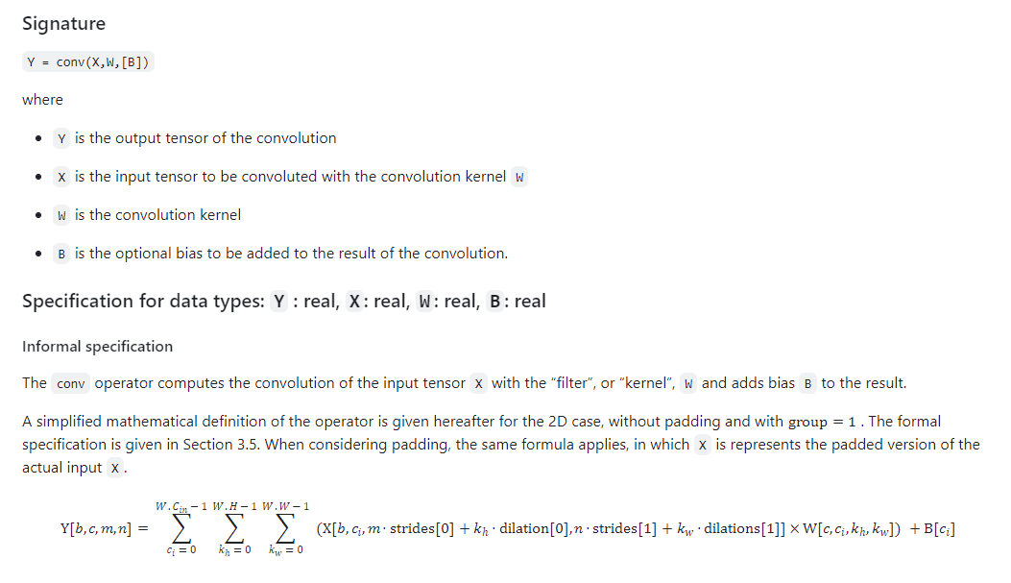

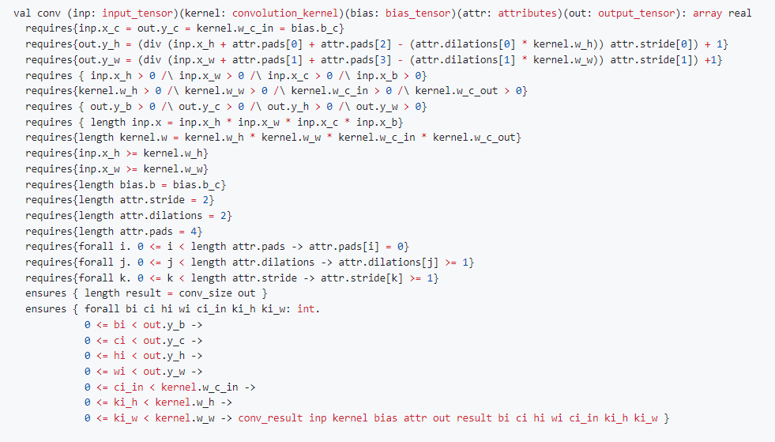
The SONNX workgroup Deliverables and planning
Contacts:
Eric JENN (eric.jenn@irt-saintexupery.com)
Jean SOUYRIS (jean.souyris@airbus.com)
github:
https://github.com/onnx/working-groups/tree/main/safety-related-profile
Oct. 2024
Dec. 2024
Dec. 2025
…
…
Bi-weekly meetings
Reqs
1st PoC
1st profile
Scope
Reqs
S
Needs
Reference
Implementation
Profile

Slide 3
In [ARP6983, §6.4.3.6]:
d. The analytical/algorithmic syntax and semantics of the ML Model, including all ML Model internal operation that are necessary to compute the output(s) of the ML Model from its inputs, are described in an unambiguous manner in the ML Model description to facilitate their implementation.

